Slide 1
Relax Zone
Genesis and foundation of a psychomedicosocial care project in a festive environment
Modus Vivendi asbl- Stadt Nacht- Newnet- Berlin-2017
Notes:
Hello everyone, I am now going to present the Relax Zone Project, created and developed by Modus Vivendi, the association I work for.

Slide 2
Modus Vivendi Mission
Modus Vivendi implements, for the benefit of drug users and with their participation, any action and any reflection aimed at reducing risks associated with drug use (AIDS, hepatitis, STD, overdose, bad trip, social isolation, etc).
Modus Vivendi promotes a reduction of risks in the field of health but also in the social field, including the risks that arise from the discourses held on drugs and drug users
Notes:
But before going further, I feel it’s important to tell you about Modus Vivendi’s history and goals.

Slide 3
History
Created in 1993, the non-profit organization Modus Vivendi becomes responsible for the prevention of AIDS aimed at drug users, implying intravenous drug injectors. In this context, the association had a coordinator’s role for all AIDS prevention actions and interventions aimed at this public within the French Community.

Slide 4
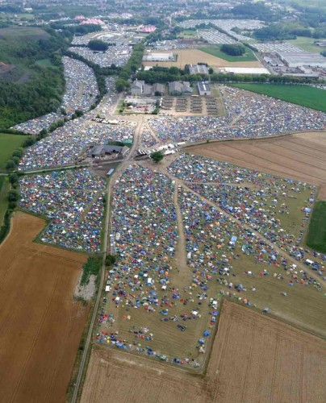
History
Gradually, the project of infectious risks prevention widened to reduction of all risks related to the consumption of all drugs (legal or illegal) whatever the modes and types of consumption.
Notes:
Since 1993 Modus has developed over 15 projects linked to drugs consumption, from access to sterile serynges for needle exchange counters, to overconsumption of alcohol within students’ circles, to festive consumptions by party goers.

Slide 5
Projects developed by Modus Vivendi
Methodology support team
Back-line team
Evaluation of projects
Publications: brochures, flyers and support information
Trainings
DAMSI: programme for accessing sterile needle equipment
Boule de neige: (i.e. Snowball) prevention through pairs
Prison: risk reduction in prisons
Notes:
Projects are grouped by teams, or front- and back-lines, i.e. Methodology support team is a back-line team

Slide 6
Projects developed by Modus Vivendi
welcome and orientation place for festive drug users
Front-line team
Modus Fiesta: welcome and orientation place for festive drugs’ users
Pill testing: analysis of drugs’ composition
Drogues risquer moins: Risk reduction information booths at festive venues
Notes:
The team I personaly coordinate is the front-line team. It gathers all projects in direct touch with consumers in festive environments (venues, festivals, ..).

Slide 7
Projects developed by Modus Vivendi
Front-line team
Quality Nights: implementing a wellbeing label for bars and clubs
Drink Different: harm reduction linked to alcohol overconsumption in students’ circles
Mobile team and Relax Zone: risk reduction interventions at festivals

Slide 8
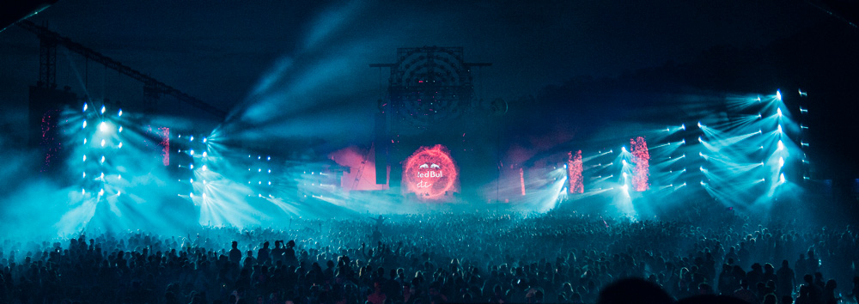
Relax Zone Definition
The Relax Zone provides care and support to people with minor physical and/or mental problems related to their use of licit and illicit psychotropic substances
Notes:
Now that I have been able to explain Modus Vivendi and its various projects, I would like to come more precisely to the Relax Zone. Here’s a brief definition

Slide 9
Relax Zone targets
It aims among other things to:
Create a privileged contact between the public and health professionals via a space created within the festive venue;
Promote listening, accompaniment and relay when necessary;
Reduce accident consequences by their early management;
Reduce the risk of dehydration, hypothermia and hyperthermia, hypoglycemia, anxiety and panic attacks;
Notes:
Here are the main objectives of this project

Slide 10
Relax Zone targets
Reduce thefts, aggressions, unprotected, and unwanted sex for all those who, due to their consumption, are less vigilant and/or underestimate risks ;
Facilitate the work of the Red Cross by taking care of people who have consumed or abused licit or illicit drugs but whose condition are not medical emergencies ;
Reduce the abuse of products that can lead to addiction.
Notes:
In festivals or large events, the Relax Zone always works in close collaboration with the Red Cross, and is always close to the Red Cross infirmary in order to facilitate care if a health situation becomes more complex (respiratory depression, tachycardia, cardiac arrhythmias, )

Slide 11
RZ-Practicalities
A calm and soothing space
Soft lighting and wall decoration
Beds made available with blankets
Access to fruits and biscuits as well as water and hot drinks
A team of volunteers composed of doctors, nurses, social workers psychologists ...
Time slots of 4 or 6 hours at a time
Teams composed of minimum one medical and one social worker
Notes:
To reach its objectives, the Relax Zone offers the following environment and services ……. In order to welcome and support festival-goers, the Relax zone team can count on the help of volunteers. In 2017 the Relax zone has counted over 40 volunteers covering two festivals (Dour and Esperanzah!) Volunteers work on 6-hour shifts on large festivals, 4-hour shifts for smaller ones. They must work minimum 3 shifts in all and in exchange, receive passes for the whole festival, food, camping space and great overall atmosphere from the team.

Slide 12
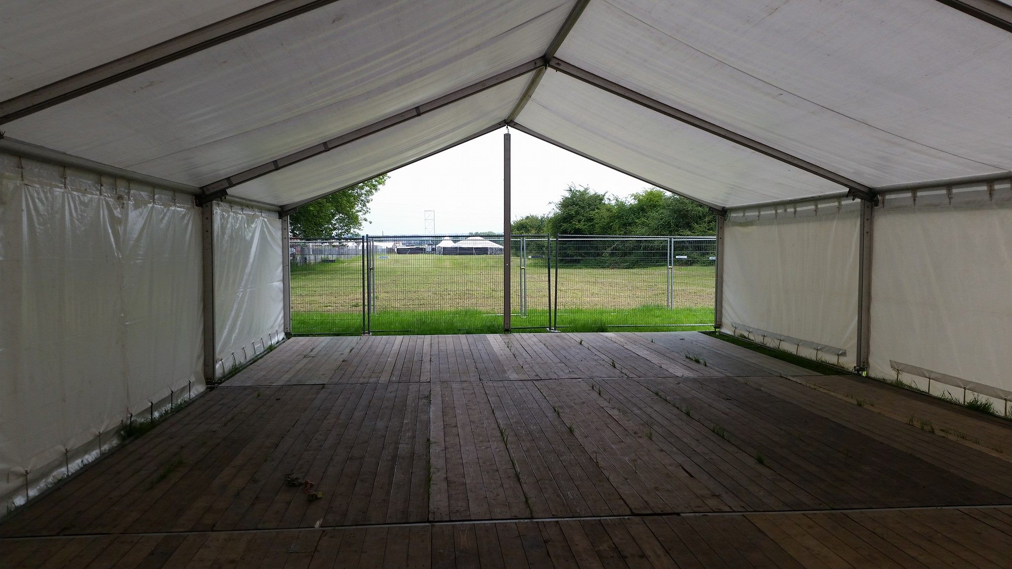
What is Relax Zone?
The first Relax Zone took place in 1997 in a large alternative music festival, from « Bad trip tent » to « Relax Zone »
A big tent, camping beds, some tea and… volunteer social workers, nurses and doctors who all have a pratice with drug users
Open 24hours a day and anonymous
Notes:
The Relax Zone project started in 1997 at the Dour music Festival, after realizing that there were a lot of consumers and that there was no structure help/support them in case of problems. The Red Cross was there but only for physical emergencies. So this was set up:

Slide 13
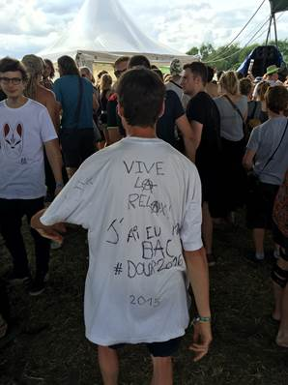
First Goal
reception and support for people experiencing a bad trip and,
avoiding, when possible, a traumatic hospitalization.
Notes:
For the info: in 2016, a festival-goer wears a T-shirt with the following inscription: Vive la Relax. J’ai été gradué. (Long live Relax; I have graduated) Does that mean that having gone through the Relax Zone means you have been « initiated »? Here are two of the Relax Zone’s goals:

Slide 14
People welcomed
Notes:
Let’s now take a look at the data we have gathered. This one is about the number of people that have been welcomed at the Relax Zone over a period of 5 years. Rentrons maintenant un peu dans les analyses de données.

Slide 15
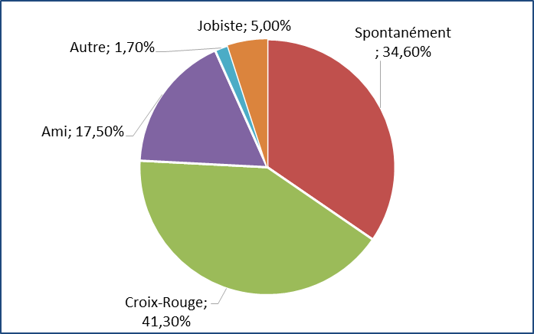
Orientation
Notes:
Whenever a person is welcomed in the Relax Zone, volunteers fill out a data sheet. This allows us to collect a series of information, such as for example where people come from. It can be seen in the pie chart that the majority of those who are welcomed are sent to us from the Red Cross. In second position, it is the people themselves who come to find us. In third place are their friends who suspect a problem probably linked to consumption. These different representations show us that the project is known by the different stakeholders of the festival. In order to make the Relax Zone known, we distribute flyers (at entrances, car parks, ..) explanatory of the Relax Zone and where it is situated on the site. For three years the festival has borne the printing costs of the flyers.

Slide 16
Average age
Notes:
As can be seen on the chart, over 20s make out the majority

Slide 17
Male/female percentage
Notes:
A question that comes up often at the festivals is that of the care of women. We can see that there is more support for men than for women. This can pose the question of consumption and consumption management. Is it the same for men as it is for women? Or, why is there so little support for women?
Over the years we have seen that it is very important that there is a mix of men and women amongst volunteer teams, because without this mix, people are more reluctant to enter the Relax Zone.

Slide 18
Products consumption
 | % 2010 (n=97) | % 2011 (n=178) | % 2012 (n=153) | % 2013 (n=167) | % 2014 (n=248) | % 2015 (n=162) | % 2016 (n=206)
Alcool | 75,3 | 77 | 66,7 | 60,5 | 69,4 | 50,0 | 62,1
XTC | 23,7 | 19,7 | 29,4 | 39,5 | 37,5 | 38,3 | 41,3
Cannabis | 34,0 | 16,9 | 28,1 | 28,1 | 27,8 | 19,1 | 19,4
LSD | 7,2 | 10,7 | 11,8 | 10,8 | 4,8 | 11,1 | 9,2
Amphétamines | 10,3 | 14 | 13,7 | 10,2 | 7,7 | 8,0 | 4,9
Cocaïne | 5,2 | 5 | 2,0 | 7,8 | 5,2 | 6,8 | 6,8
Autres (RC, ne sait pas, mélanges de produits…) | 1,0 | 1 | 9,8 | 10,8 | 4,4 | 6,2 | 6,3
Kétamine | 0,0 | 0 | 8,5 | 3,6 | 2,8 | 5,6 | 9,7
Champignons hallucinogènes | 3,1 | 3 | 2,6 | 1,2 | 2,4 | 1,2 | 2,4
Benzodiazépines | 1,0 | 1 | 8,5 | 1,2 | 0,4 | 1,2 | 0,0
GHB | 0,0 | 0 | 0,0 | 1,2 | 0,4 | 0 | 0,5
Héroïne | 0 | 0 | 0,0 | 0 | 0,0 | 0 | 0,0
Notes:
Whenever possible and when opportunity arises, we enquire about the products consumed during the festival. We can thus conclude from this data that the main products are: alcohol, XTC, cannabis. An important point has been the consumption of research chemicals in 2012 and 2013, that was close to the one of amphetamines.

Slide 19
We can make harm reduction with these people
Prevention of the use of stimulant substances because they are so tired.
Prevention of excessive consumption of psychoactive substances by providing a place to retire for a break
Prevention and/or reduction of accidents for those who have crossed the limits of the drugs’ abuse. We take care of them and step by step, lead them to a stable condition and out of danger.
Prevention to reduce thefts, attacks, unprotected and/or unwanted sex, to all those for whom the decrease of vigilance is due to use of products that lead to underestimate risks.

Slide 20
Reasons for using RZ
 |  | n | %
Were admitted because of* : |  | 248*
 | Tired | 170 | 68,5
 | Anguish/stress/bad trip | 55 | 22,2
 | Cold, hypothermia | 42 | 16,9
 | Disorientation | 40 | 16,1
 | Heat, insulation | 21 | 8,5
 | Nausea, throwing up | 24 | 9,7
 | Problems to find a place to stay, loss/theft of material (tent, clothing, bag, key…) | 4 | 1,6
 | Need to talk | 26 | 10,5
 | Discomfort, vertigo | 15 | 6,0
 | Headaches | 12 | 4,8
 | Hallucination, paranoïa | 10 | 4,0
 | Other physical aches, injuries | 5 | 2,0
 | Other (descent, rise, gastro, loss of …) | 18 | 7,3
 | Tachycardy | 3 | 1,2
 | Insomnia | 6 | 2,4
 | Alcohol intoxication |  | 0,0
 | Agitation, nervousness | 1 | 0,4
 | Mechanical disorders | 5 | 2,0
 | Unconsciousness | 2 | 0,8
Notes:
Here are the reasons for using the Relax Zone: the main one is fatigue, followed by feelings of anguish and bad trips. It is interesting to note that fatigue is often invoqued because people are afraid to say they have consumed illegal products.

Slide 21
Some figures
In 2016, 263 festival-goers were taken care of, during three Belgian festivals: Dour Music Festival and Esperanzah! festival
One example from the Dour Music Festival : from Wednesday 4:00 pm till the following Monday morning, 24/24 hours a day, with no less than 34 volunteers who took turns by 3-people-strong teams (2 social workers and one paramedical or medical worker) and a team coordinator to take care of the festival-goers who, for diverse reasons, land in the Relax Zone.

Slide 22
Length of stay
Notes:
The pie chart indicates how much time in average people stay at the Relax Zone. The majority spend between one and a half to six hours; and only three percent stay for over 10 hours

Slide 23
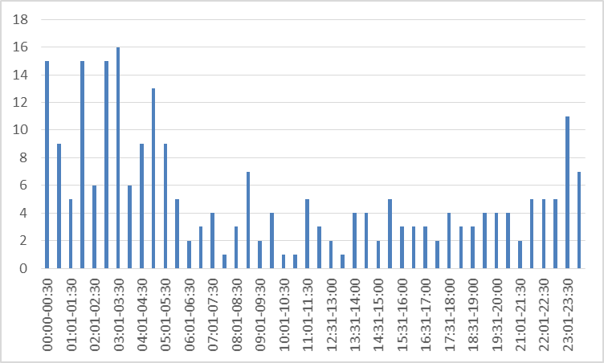
Arrival time
Notes:
This year we wished to know at what time the highest number of people stay at the Relax Zone and it appears to be between 11 in the evening to 5 in the morning.

Slide 24
Complementarity Work cooperation
The relax zone work is complementary to the work of the Red Cross (urgent medical interventions).
The Red Cross aren’t suitable in the managing of drugs’ consumption problems in recreational places, including the anonymity of the beneficiary.
We work with the cooperation of all parties involved (organizers, Red Cross, security…).
For example, the security people know about our interventions and will send the person who is feeling bad over to the relax zone; this is good for the party.

Slide 25
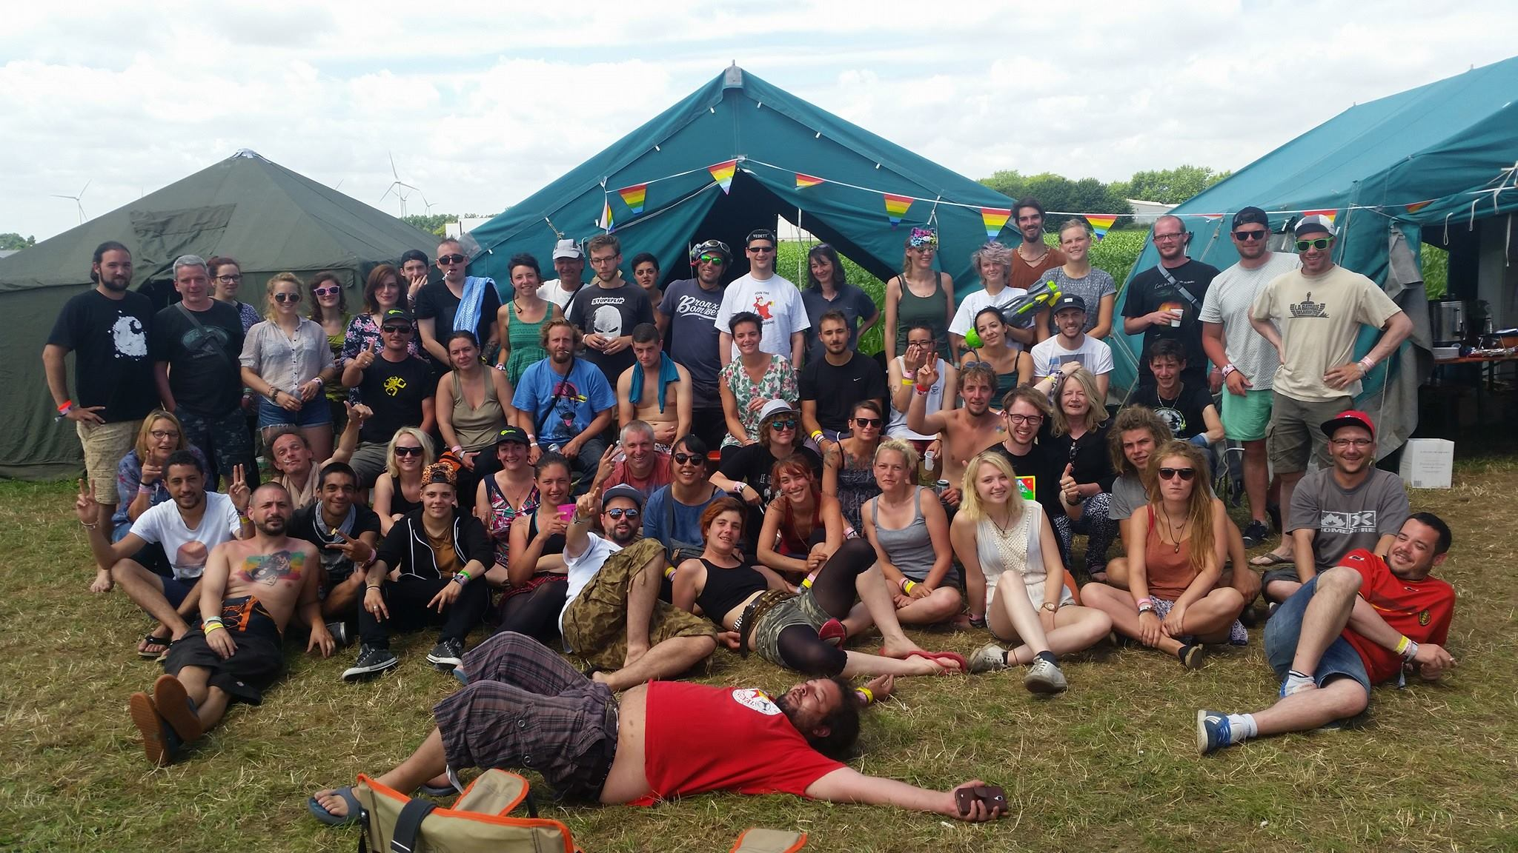
Year after year
Since 2003 Relax Zones appeared in other events: indoor and outdoor, world music festivals, rock & electroonic festivals, large techno parties…
Since 2003 Modus Vivendi has organized over 50 relax Zones in Belgium’s French speaking community

